Slide 1
Streams, File I/O, and Networking
Chapter 10

Slide 2
Objectives
Describe the concept of an I/O stream
Explain the difference between text and binary files
Save data, including objects, in a file
Read data, including objects, in a file

Slide 3
Overview: Outline
The Concept of a Stream
Why Use Files for I/O?
Text Files and Binary Files

Slide 4
The Concept of a Stream
Use of files
Store Java classes, programs
Store pictures, music, videos
Can also use files to store program I/O
A stream is a flow of input or output data
Characters
Numbers
Bytes

Slide 5
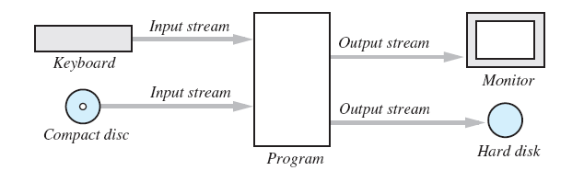
The Concept of a Stream
Streams are implemented as objects of special stream classes
Class Scanner
Object System.out
Figure 10.1 I/O Streams

Slide 6
Why Use Files for I/O
Keyboard input, screen output deal with temporary data
When program ends, data is gone
Data in a file remains after program ends
Can be used next time program runs
Can be used by another program

Slide 7
Text Files and Binary Files
All data in files stored as binary digits
Long series of zeros and ones
Files treated as sequence of characters called text files
Java program source code
Can be viewed, edited with text editor
All other files are called binary files
Movie, music files
Access requires specialized program

Slide 8
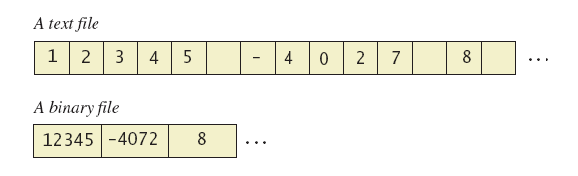
Text Files and Binary Files
Figure 10.2 A text file and a binary file containing the same values

Slide 9
Text-File I/O: Outlline
Creating a Text File
Appending to a text File
Reading from a Text File

Slide 10
Creating a Text File
Class PrintWriter defines methods needed to create and write to a text file
Must import package java.io
To open the file
Declare stream variable for referencing the stream
Invoke PrintWriter constructor, pass file name as argument
Requires try and catch blocks

Slide 11
Creating a Text File
File is empty initially
May now be written to with method println
Data goes initially to memory buffer
When buffer full, goes to file
Closing file empties buffer, disconnects from stream

Slide 12

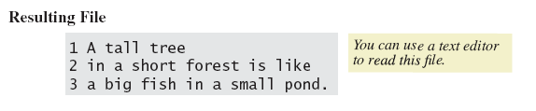
Creating a Text File
View sample program, listing 10.1 class TextFileOutput
Sample screen output

Slide 13
Creating a Text File
When creating a file
Inform the user of ongoing I/O events, program should not be "silent"
A file has two names in the program
File name used by the operating system
The stream name variable
Opening, writing to file overwrites pre-existing file in directory

Slide 14
Appending to a Text File
Opening a file new begins with an empty file
If already exists, will be overwritten
Some situations require appending data to existing file
Command could be outputStream = new PrintWriter( new FileOutputstream(fileName, true));
Method println would append data at end

Slide 15
Reading from a Text File
Note text file reading program, listing 10.2 class TextFileInputDemo
Reads text from file, displays on screen
Note
Statement which opens the file
Use of Scanner object
Boolean statement which reads the file and terminates reading loop

Slide 16
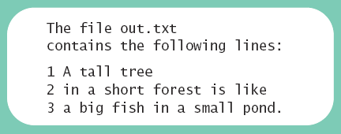
Reading from a Text File
Sample screen output

Slide 17
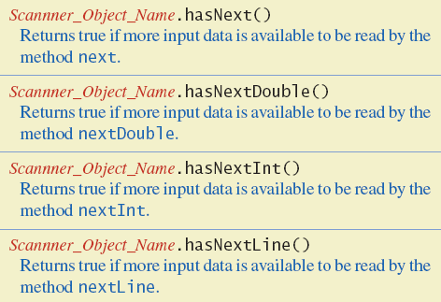
Reading from a Text File
Figure 10.3 Additional methods in class Scanner

Slide 18
Techniques for Any File
The Class File
Programming Example: Reading a File Name from the Keyboard
Using Path Names
Methods of the Class File
Defining a Method to Open a Stream

Slide 19
The Class File
Class provides a way to represent file names in a general way
A File object represents the name of a file
The object new File ("treasure.txt") is not simply a string
It is an object that knows it is supposed to name a file

Slide 20
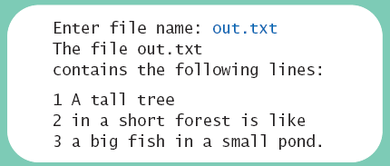
Programming Example
Reading a file name from the keyboard
View sample code, listing 10.3 class TextFileInputDemo2
Sample screen output

Slide 21
Using Path Names
Files opened in our examples assumed to be in same folder as where program run
Possible to specify path names
Full path name
Relative path name
Be aware of differences of pathname styles in different operating systems

Slide 22
Methods of the Class File
Recall that a File object is a system-independent abstraction of file's path name
Class File has methods to access information about a path and the files in it
Whether the file exists
Whether it is specified as readable or not
Etc.

Slide 23
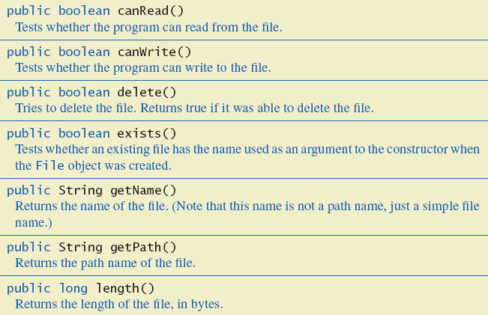
Methods of the Class File
Figure 10.4 Some methods in class File

Slide 24
Defining a Method to Open a Stream
Method will have a String parameter
The file name
Method will return the stream object
Will throw exceptions
If file not found
If some other I/O problem arises
Should be invoked inside a try block and have appropriate catch block

Slide 25
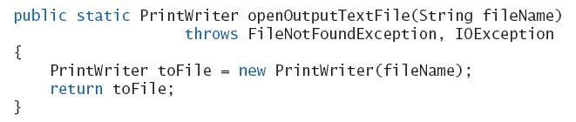
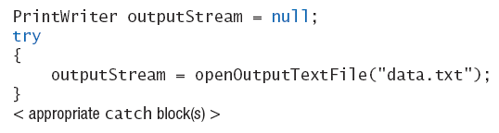
Defining a Method to Open a Stream
Example code
Example call

Slide 26
Case Study Processing a Comma-Separated Values File
A comma-separated values or CSV file is a simple text format used to store a list of records
Example from log of a cash register’s transactions for the day:
SKU,Quantity,Price,Description
4039,50,0.99,SODA 9100,5,9.50,T-SHIRT
1949,30,110.00,JAVA PROGRAMMING TEXTBOOK
5199,25,1.50,COOKIE

Slide 27
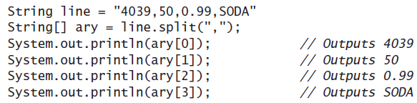
Example Processing a CSV File
View program that calculates total sales, listing 10.4 class TransactionReader
Uses the split method which puts strings separated by a delimiter into an array

Slide 28
Basic Binary-File I/O
Creating a Binary File
Writing Primitive Values to a Binary File
Writing Strings to a Binary File
The Class EOFException
Programming Example: Processing a File of Binary Data

Slide 29
Creating a Binary File
Stream class ObjectOutputStream allows files which can store
Values of primitive types
Strings
Other objects
View program which writes integers, listing 10.5 class BinaryOutputDemo

Slide 30

Creating a Binary File
Sample screen output
Note the line to open the file
Constructor for ObjectOutputStream cannot take a String parameter
Constructor for FileOutputSream can

Slide 31
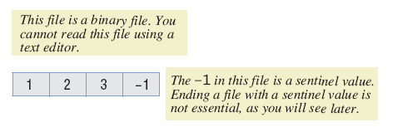
Writing Primitive Values to a Binary File
Method println not available
Instead use writeInt method
View in listing 10.5
Binary file stores numbers in binary form
A sequence of bytes
One immediately after another

Slide 32
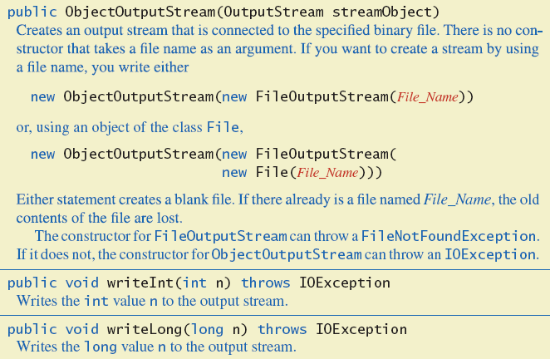
Writing Primitive Values to a Binary File
Figure 10.5a Some methods in class ObjectOutputStream

Slide 33
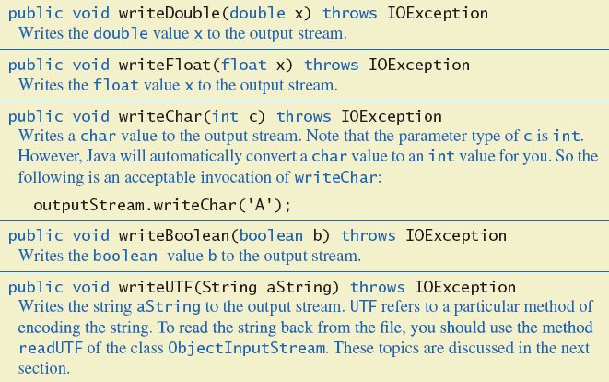
Writing Primitive Values to a Binary File
Figure 10.5b Some methods in class ObjectOutputStream

Slide 34
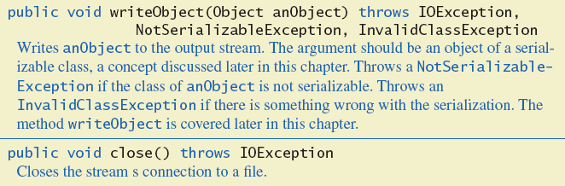
Writing Primitive Values to a Binary File
Figure 10.5c Some methods in class ObjectOutputStream

Slide 35
Writing Strings to a Binary File
Use method writeUTF
Example outputStream.writeUTF("Hi Mom");
UTF stands for Unicode Text Format
Uses a varying number of bytes to store different strings
Depends on length of string
Contrast to writeInt which uses same for each

Slide 36
Reading from a Binary File
File must be opened as an ObjectInputStream
Read from binary file using methods which correspond to write methods
Integer written with writeInt will be read with readInt
Be careful to read same type as was written

Slide 37
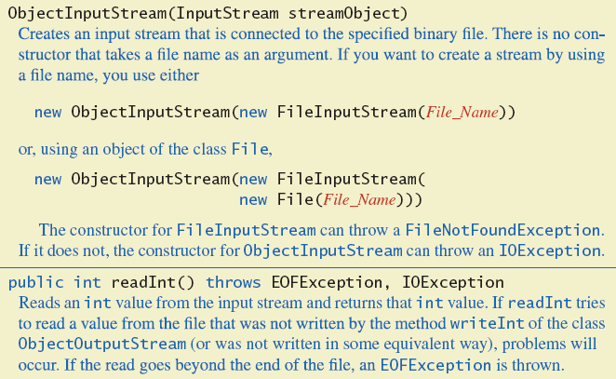
Reading from a Binary File
Figure 10.6a Some methods of class ObjectInputStream

Slide 38
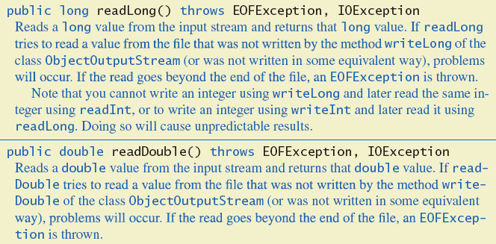
Reading from a Binary File
Figure 10.6b Some methods of class ObjectInputStream

Slide 39
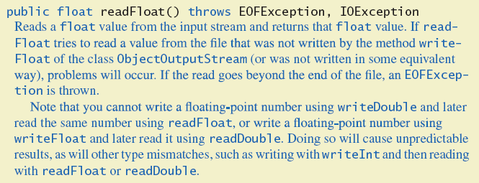
Reading from a Binary File
Figure 10.6c Some methods of class ObjectInputStream

Slide 40
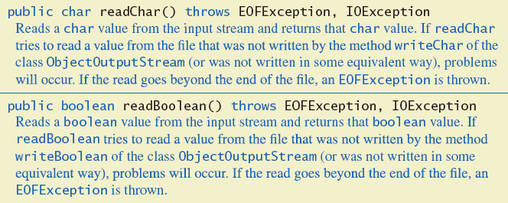
Reading from a Binary File
Figure 10.6d Some methods of class ObjectInputStream

Slide 41
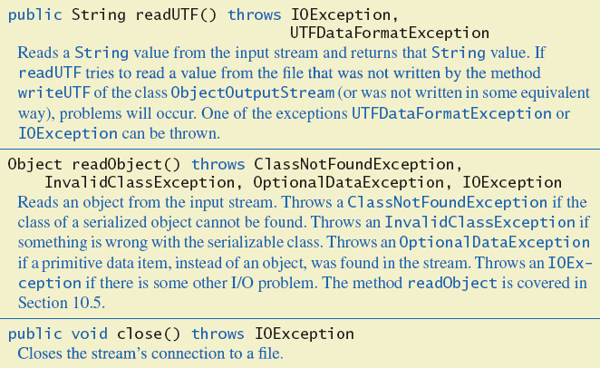
Reading from a Binary File
Figure 10.6e Some methods of class ObjectInputStream

Slide 42
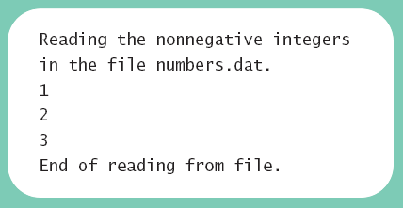
Reading from a Binary File
View program to read, listing 10.6 class BinaryInputDemo
Sample screen output

Slide 43
The Class EOFException
Many methods that read from a binary file will throw an EOFException
Can be used to test for end of file
Thus can end a reading loop
View example program, listing 10.7 class EOFExceptionDemo

Slide 44
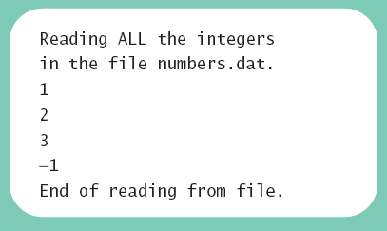
The Class EOFException
Note the -1 formerly needed as a sentinel value is now also read
Always a good idea to check for end of file even if you have a sentinel value
Sample screen output

Slide 45
Programming Example
Processing a file of binary data
Asks user for 2 file names
Reads numbers in input file
Doubles them
Writes them to output file
View processing program, listing 10.8 class Doubler

Slide 46
Binary-File I/O, Objects & Arrays
Binary-File I/O with Objects of a Class
Some Details of Serialization
Array Objects in Binary Files

Slide 47
Binary-File I/O with Class Objects
Consider the need to write/read objects other than Strings
Possible to write the individual instance variable values
Then reconstruct the object when file is read
A better way is provided by Java
Object serialization – represent an object as a sequence of bytes to be written/read
Possible for any class implementing Serializable

Slide 48
Binary-File I/O with Class Objects
Interface Serializable is an empty interface
No need to implement additional methods
Tells Java to make the class serializable (class objects convertible to sequence of bytes)
View sample class , listing 10.9 class Species

Slide 49
Binary-File I/O with Class Objects
Once we have a class that is specified as Serializable we can write objects to a binary file
Use method writeObject
Read objects with method readObject();
Also required to use typecast of the object
View sample program, listing 10.10 class ObjectIODemo

Slide 50
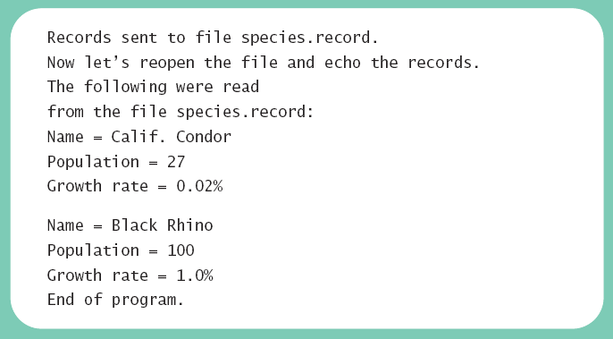
Binary-File I/O with Class Objects
Sample screen output

Slide 51
Some Details of Serialization
Requirements for a class to be serializable
Implments interface Serializable
Any instance variables of a class type are also objects of a serializable class
Class's direct superclass (if any) is either serializable or defines a default constructor

Slide 52
Some Details of Serialization
Effects of making a class serializable
Affects how Java performs I/O with class objects
Java assigns a serial number to each object of the class it writes to the ObjectOutputStream
If same object written to stream multiple times, only the serial number written after first time

Slide 53
Array Objects in Binary Files
Since an array is an object, possible to use writeObject with entire array
Similarly use readObject to read entire array
View array I/O program, listing 10.11 class ArrayIODemo

Slide 54
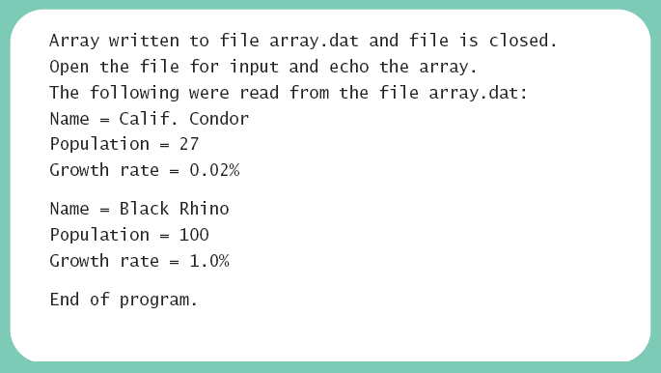
Array Objects in Binary Files
Sample screen output

Slide 55
Introduction to Sockets and Networking
Classes such as Scanner and PrintWriter can be used with any data stream – such as communicating over a network using streams
Java uses sockets
A socket consists of the address that identifies the remote computer and a port ranging from 0 to 65535
The process of communicating between a client and server is shown in the following figure

Slide 56
FIGURE 10.7 Client/Server Network Communication via Sockets
The Java server program listens and waits for a connection on port 6789. Different programs may be listening on other ports.
Server Computer
port 0
port 1
In Listing 10.13 the server and client are running on the same computer which is identified by the special address of “localhost”.
Java
server
program
…
port 6789
…
The Java client program connects to the server on port 6789. It uses a local port that is assigned automatically, in this case, port 8312.
Server Computer
Client Computer
port 0
port 0
port 1
port 1
Java
server
program
…
Network
…
Java
client
program
port 6789
port 8312
…
…
The Java server program can now communicate over a socket bound locally to port 6789 and remotely to the client’s address at port 8312, while the client communicates over a socket bound locally to port 8312 and remotely to the server’s address at port 6789.

Slide 57
Introduction to Sockets and Networking
Server program
Listen for a connection on a specified port; when one is made:
Create a Scanner with an InputStreamReader based on the socket that the server will listen on; use this for input from a client
Create a PrintWriter with the socket to send data to the client
See Listing 10.12
Client program
Initiate a connection to the server on a specified port
Create a Scanner to read from the socket
Create a PrintWriter to send to the socket
Set Listing 10.13

Slide 58
The URL Class
The URL class gives us a simple way to read from a webpage
Thanks to polymorphism we can create a Scanner that is linked to a website
The example outputs the text from wikipedia
URL website = new
URL("http://www.wikipedia.org");
Scanner inputStream = new Scanner(
new InputStreamReader(website.openStream()));
while (inputStream.hasNextLine())
{
String s = inputStream.nextLine();
System.out.println(s);
}
inputStream.close();

Slide 59
Graphics Supplement
Programming Example
A JavaFX GUI for Manipulating Files

Slide 60
Programming Example
A JavaFX GUI for manipulating files
Note buttons
Show first line
Remove file
Reset
Note also the text fields
Type in a file name
Display first line of file

Slide 61
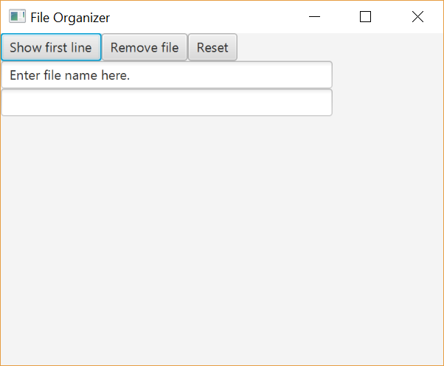
Programming Example
View JavaFX program, listing 10.14 class FileOrganizer
Sample screen output

Slide 62
Summary
Files with characters are text files
Other files are binary files
Programs can use PrintWriter and Scanner for I/O
Always check for end of file
File name can be literal string or variable of type String
Class File gives additional capabilities to deal with file names

Slide 63
Summary
Use ObjectOutputStream and ObjectInputStream classes enable writing to, reading from binary files
Use writeObject to write class objects to binary file
Use readObject with type cast to read objects from binary file
Classes for binary I/O must be serializable

